Slide 1

Introducing mysel
Areeba Nasir

Slide 2
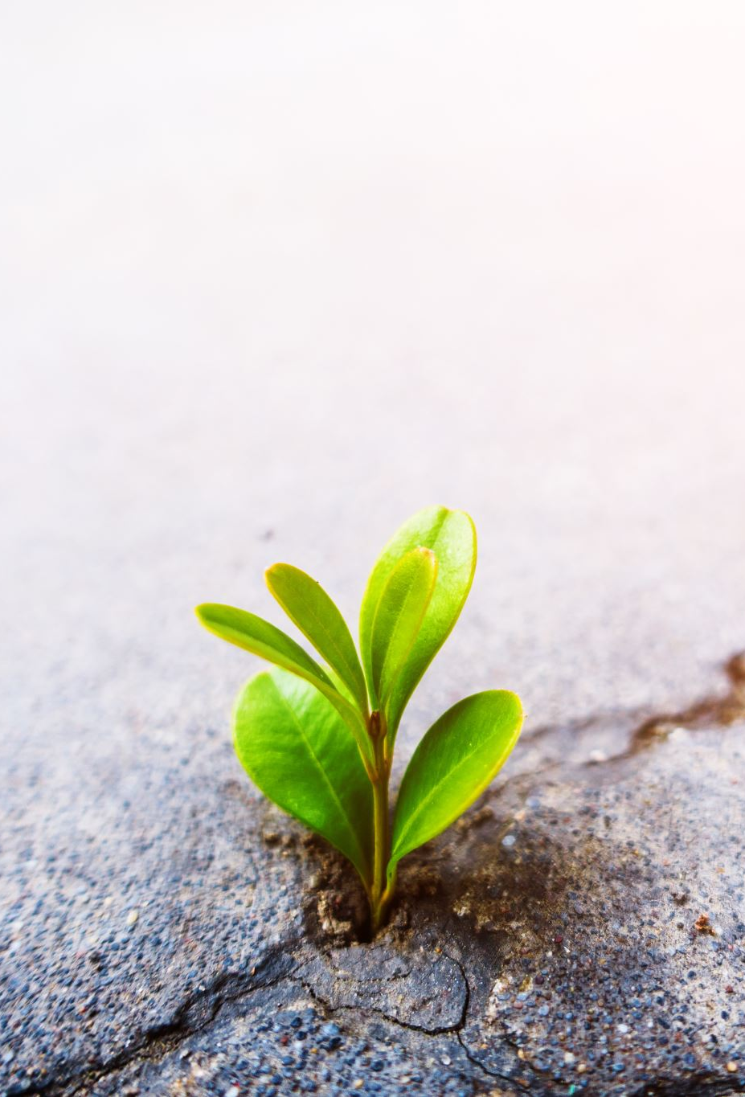
Family
My life goes around my family.my parents and my siblings . They conclude my support system,my emotional support,my motivation and my whole life .

Slide 3

Friends
Friendship is like the most real and unique feeling or relationship that I have ever experienced. Friends are like not to gain something but all about sacrifice you for them , atleast that is what my believe is .

Slide 4

Career
Career always attaches to our professional education,career is all about dreams and the ways to achieve them . My aim is all about working what makes me happy. So my field Will not only my profession but passion.

Slide 5

Skills
If I discuss about my skills so I am good with creatives and graphics and I also run a page on insta on the graphics and trying to do great.
Skills

Slide 6
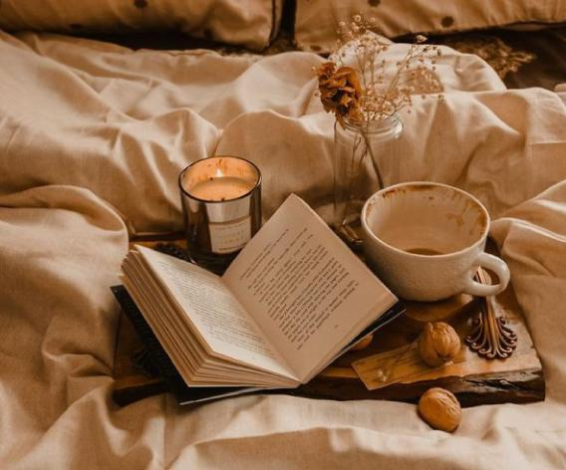
Hobbies
My free time is all goes in reading, reading is not what I like but it is like a craze, reading is like my life . I need it in my every mood either I am happy or depressed I need it .

Slide 7

Novels
I always prefer reading novels specially Urdu novel. Urdu language is so precious and rich cultured language,full of emotions and feelings.

Slide 8

Writter
As my all life is about reading my favorite writter is UMERA AHMED. Her novels hold the vibe that I can’t ignore.

Slide 9

Books
My second preference for reading is self help books , They actually do the work they name for. They internally really help you growing without even realizing you .

Slide 10

Pisces
As my star is pieces and it is specified for the people who always have their on step in reality and the other in fantasy. Reality around me is all because of people around me and fantasy of course is the gift of reading.

Slide 11

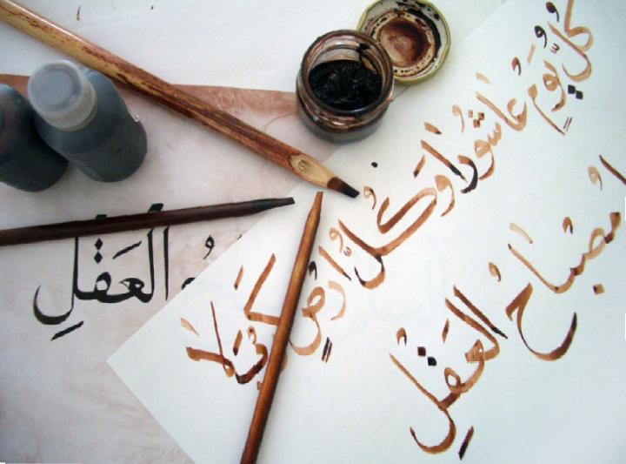
Calligraphy
I have great interest in calligraphy and planning to learn it soon as it is on the top my wish to do list now.

Slide 12

Rest
All that rest is about adding some good in the environment and in the lives of my good ones.

